Slide 1

Team members: 1) Syead Maaz Ahmed 2) Amrit Shukla
Noting Web App

Slide 2
Project Overview
A Web App to take notes in classes can be quite handy as everyone has a laptop these days. For the ease of the students this app is being created by our team.
The main aim is to add notes of various subjects such as Physics, Chemistry, Mathematics and any other type of notes in a different folder which we named as ANY KIND OF GENERAL NOTE placed at top right corner.
Different notes of different subjects will be saved in their respective subjects folders. We have provided the DARK MODE in our app.
The basic function of this app:
* Add notes,
* Edit notes or
* Delete notes at any time
* Notes that users will be creating is going to be displayed with their last edited date and time.

Slide 3
Solution
Our approach towards the solution:
We initiated the Web App work with some of the well known languages such as HTML, Cascading style sheets, JavaScript.
Through HTML, the appearance of images, links, headings, text, page layout and just about every element of a web page is formatted. In easy words we can explain, we structured the content through HTML.
With the help of CSS, we designed our web pages, controlled the look and feel of the content written in HTML. It means that if we have a website element, let’s say a “title”, and we want to make the text size “20px”, the color “black”, and the padding around it “10px”, we would use CSS to control the look of our element.
JavaScript basically controls the behavior of the page. All the popups, cool transitions, scrolling animations, and other attractive aspects of our Web App are created using JavaScript.
We worked on back-end using JavaScript.
The function of enabling or disabling of dark/light theme (switching between theme), popups, are managed by JavaScript.
Adding, deleting specific/entire notes, editing of notes. displaying of saved notes.
Last edited date and time.
Saving notes and show saved successfully pop-ups display. We were able to perform these functions mentioned in the last four points with the help of JavaScript.

Slide 4
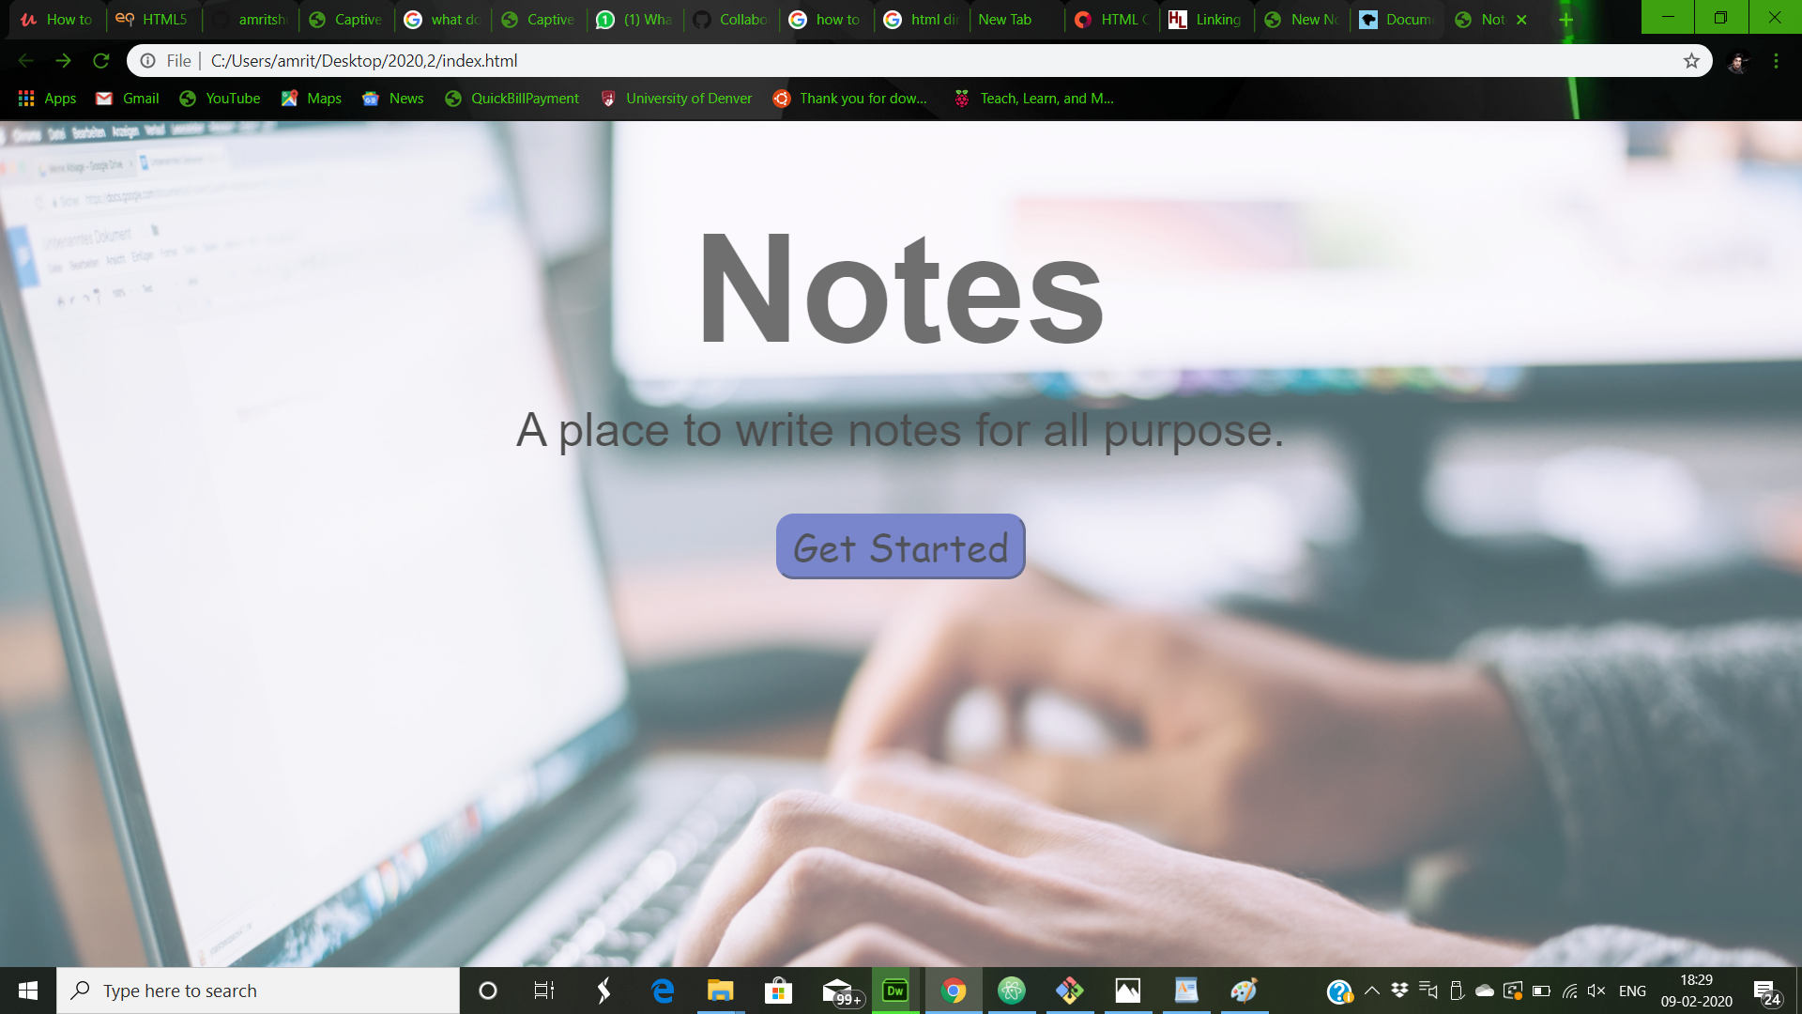
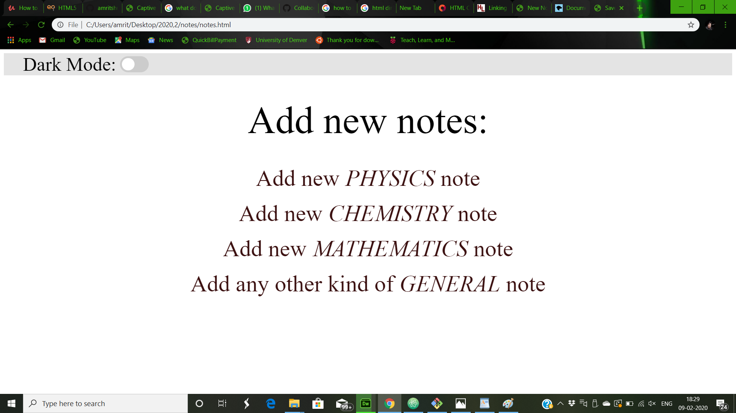
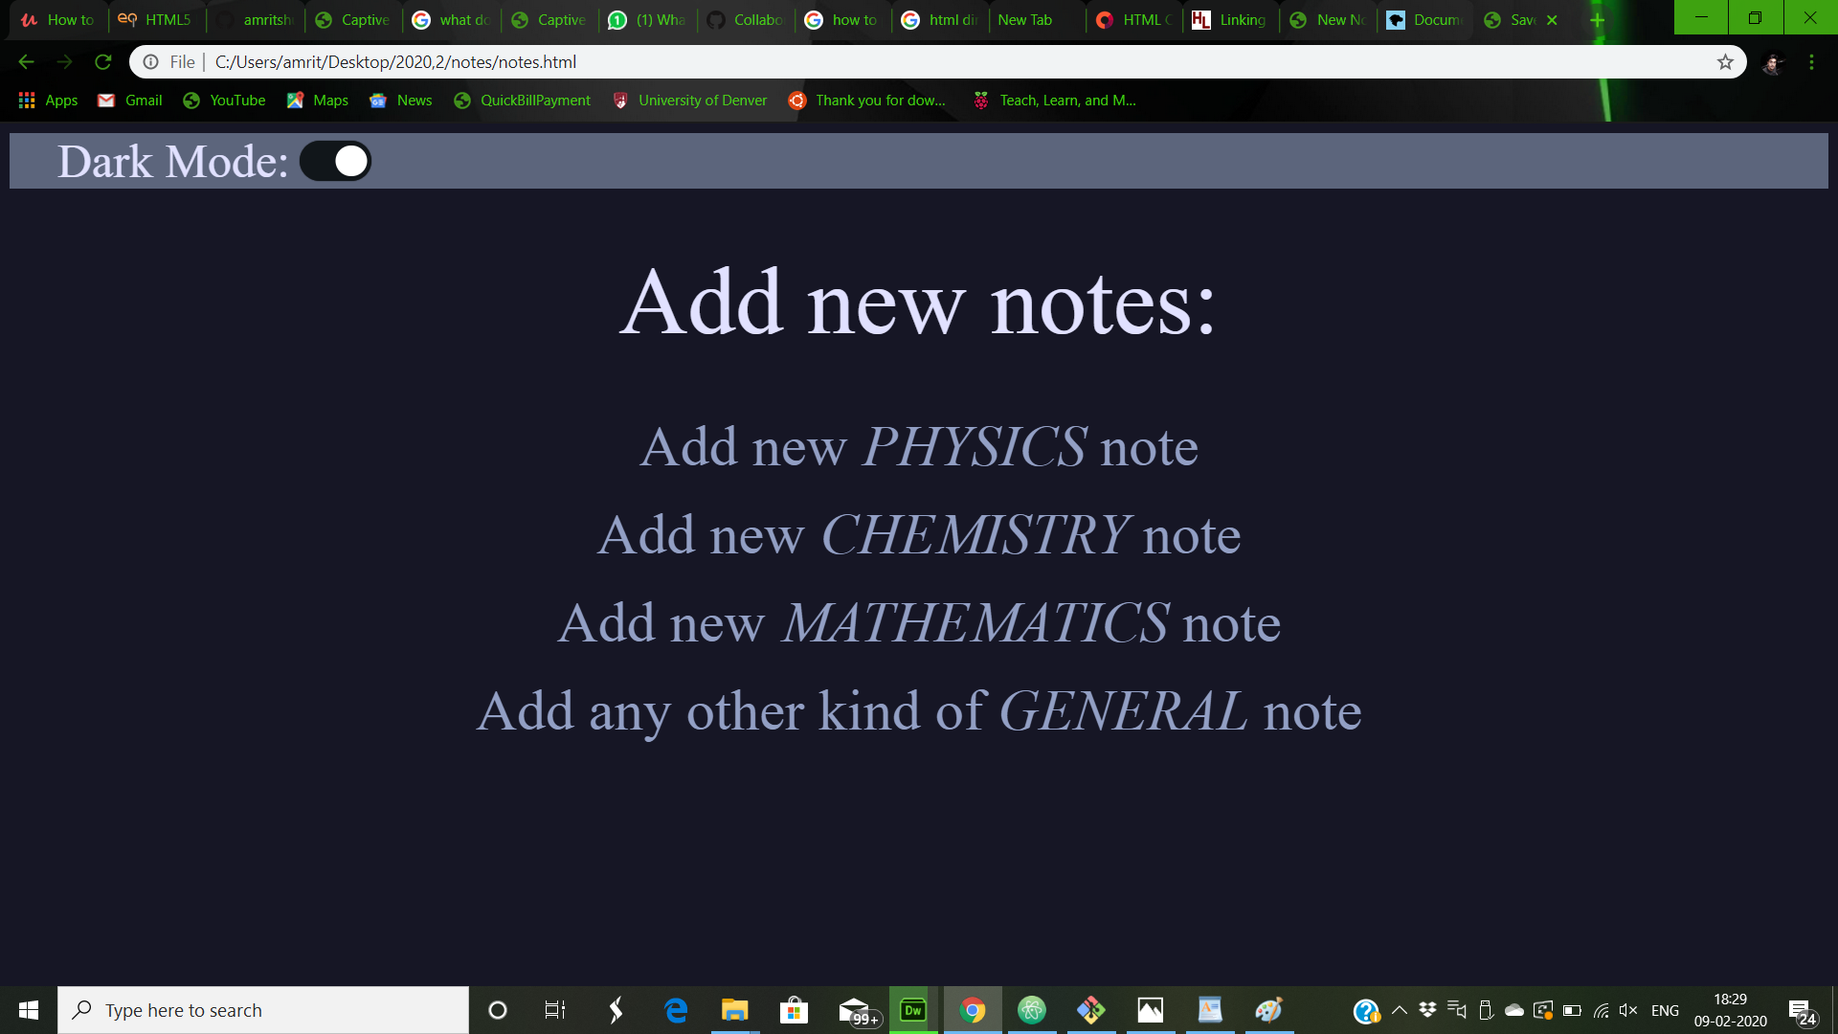
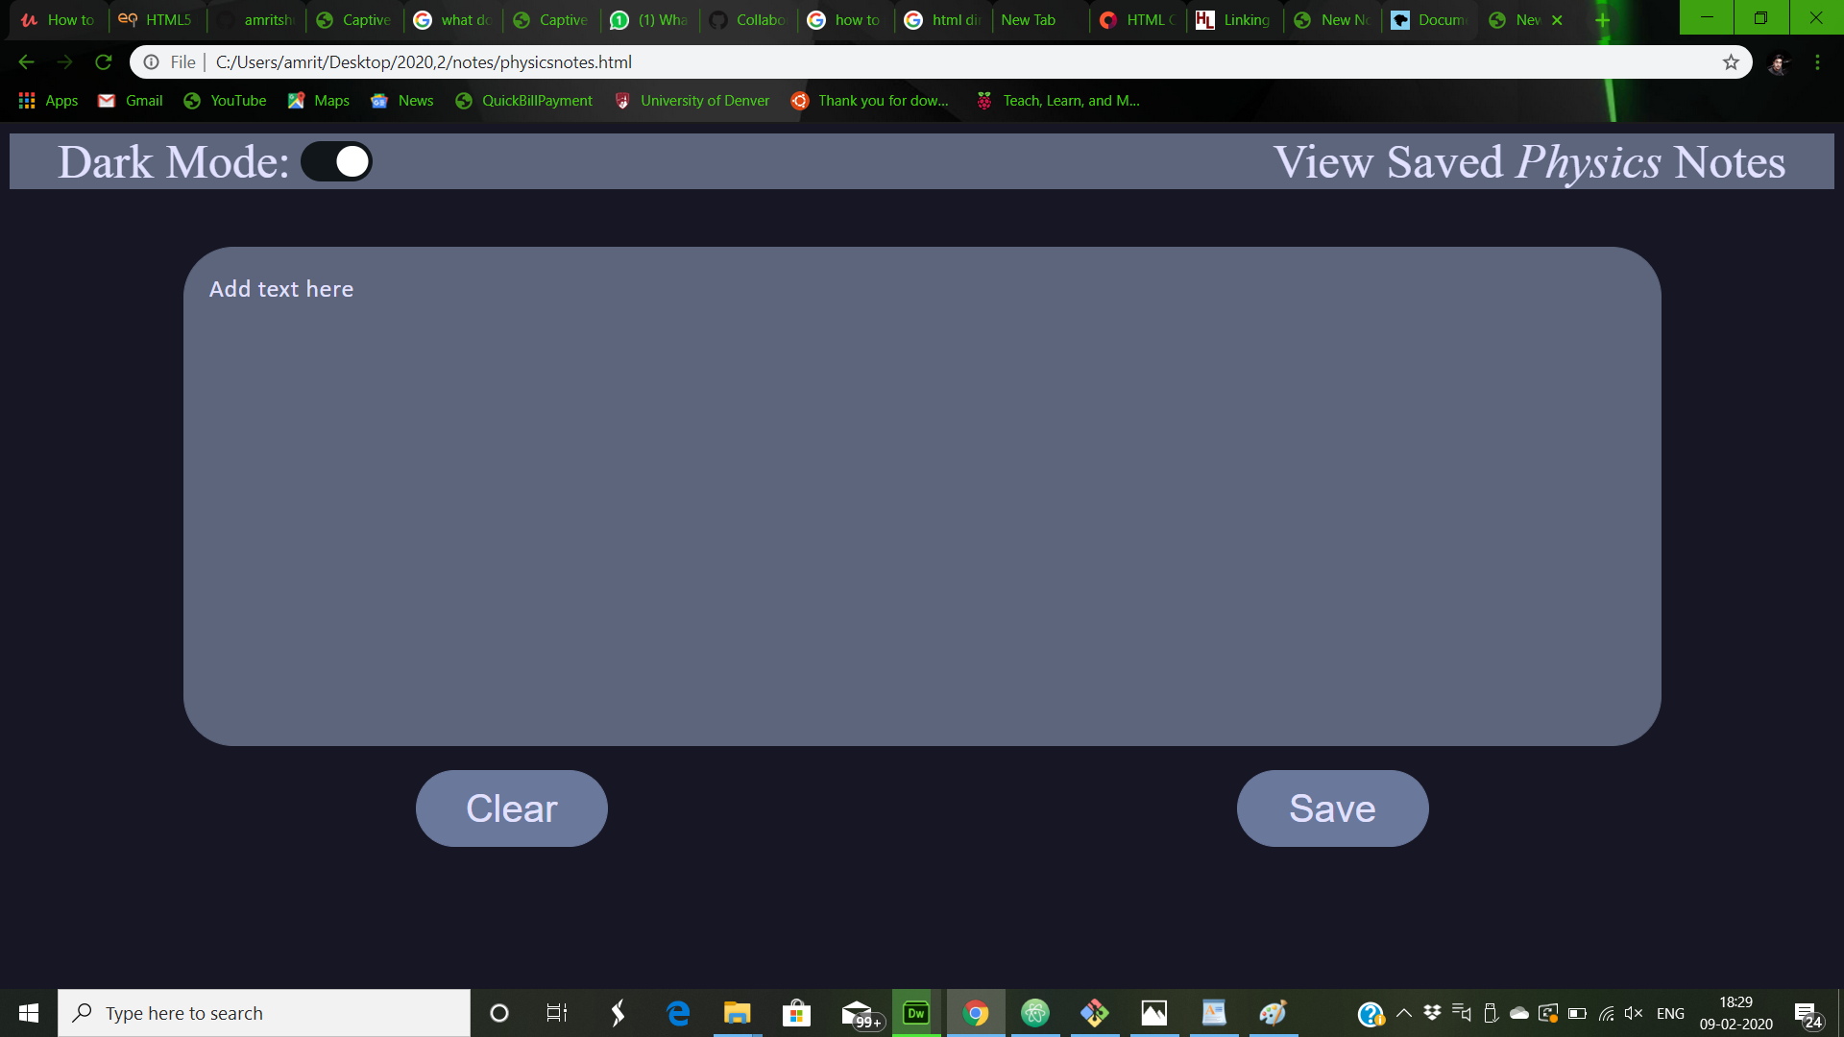

Slide 5
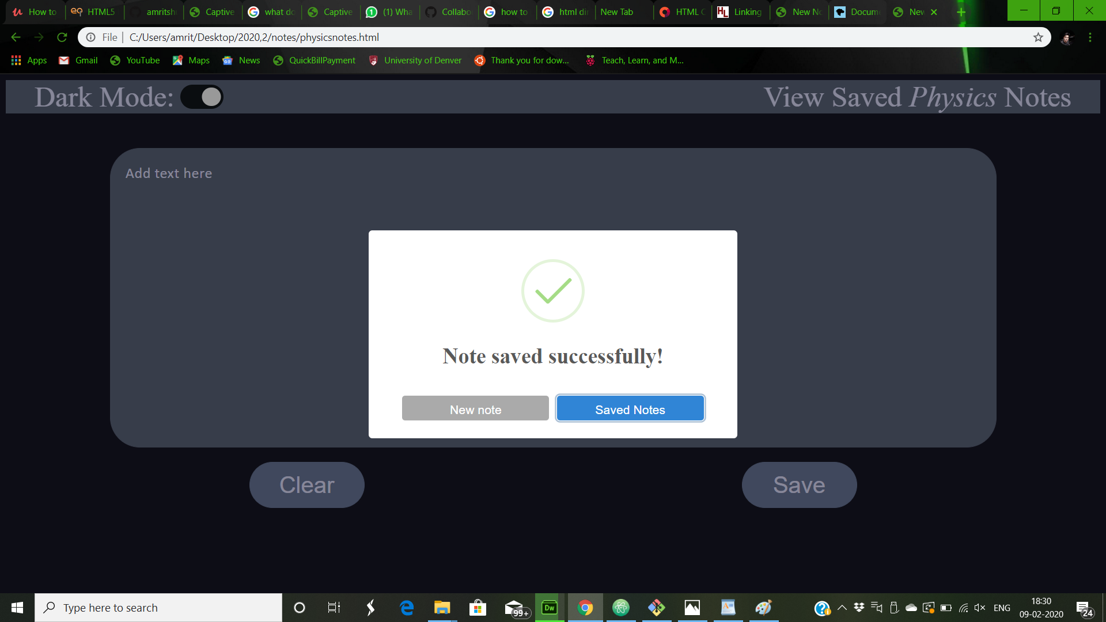
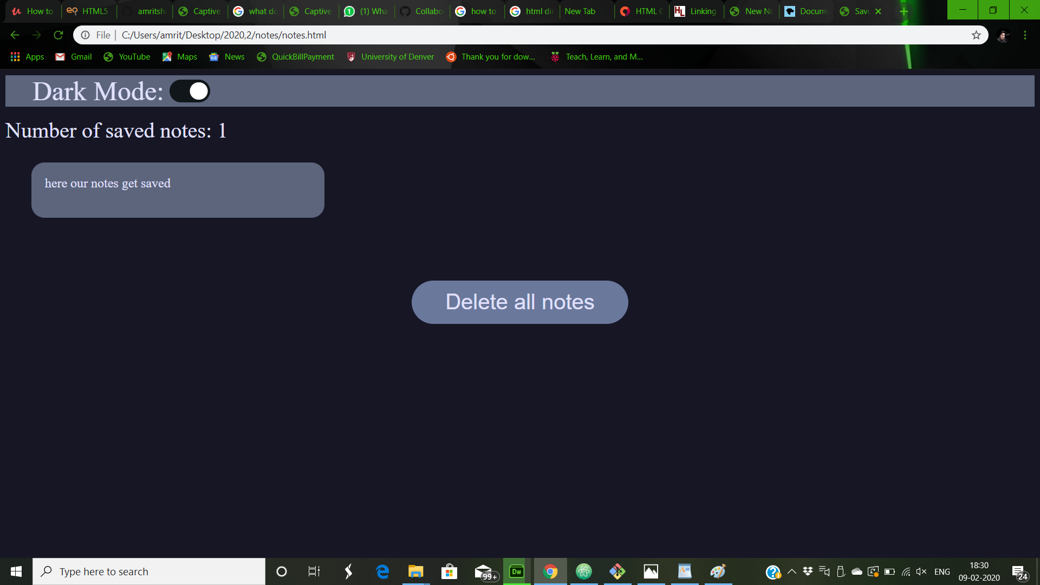
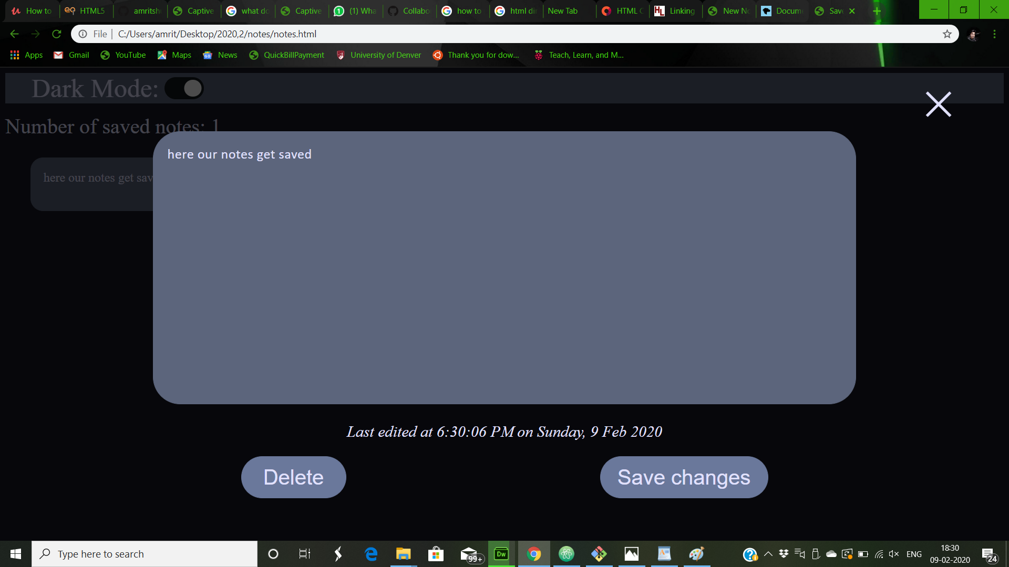
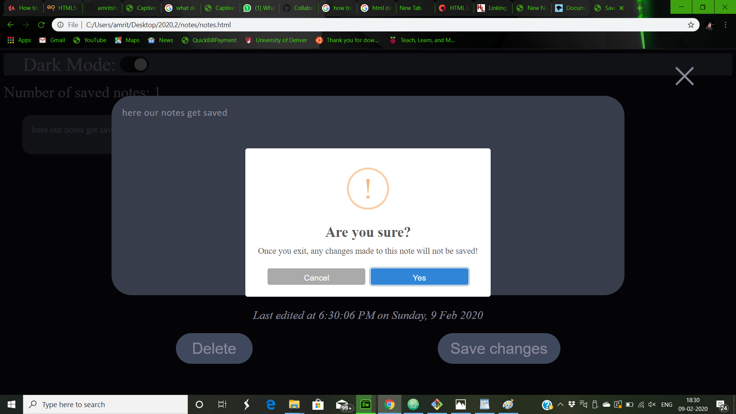

Slide 6
SETUP REQUIRED TO RUN
Atom.exe or any other text editor.
Instructions to run submitted code:
* Run the code with any text editor(preferably atom)

Slide 7
TECHNOLOGIES USED
HTML5
CSS
JAVA-SCRIPT

Slide 8
HTML FILES
index.html
notes.html
physicsnotes.html
chemistrynotes.html
mathematicsnotes.html
generalnotes.html

Slide 9
CSS FILES
homestyle.css
savednotestyle.css
notestyle.css

Slide 10
JAVA-SCRIPT
script.js
saved.js

